Slide 1

Life Expectancy: Unpacking the Global Drivers of a Long Life
Alex Ryan
Catie Lutz
Summer Baptiste
Judy Samuels
Colin O’Neill

Slide 2
Study Overview
Data: Life Expectancy data provided by WHO (2000-2015)
22 total variables
Scope of Study: Education, Disease/Immunization, BMI, Alcohol, and Health Expenditure in relation to Life Expectancy
Hypothesis:
The scope of this study is to determine what factors have the greatest impact on life expectancy on a global scale.

Slide 3

Life Expectancy vs. Schooling
Schooling = avg. # of years of formal education per capita

Slide 4

Data Cleaning
Notes:
Read in a csv of life expectancy data compiled by the World Health Organization
Do a df.columns in order to get view into how many columns are in the dataset and determine which variables/columns are most vital for our life expectancy analysis
We chose *insert variables that we chose as a team*
Each team member trim the columns in the dataframe to focus on their assigned column/variable
Do a df.count to ensure there are uniform counts in each column of your trimmed dataframe
Investigate the discrepancies
For the schooling df, there were ~160 “NaN” values and ~7 “0” values
Decided to drop these from the data rather than filling in replacement values as we still had a healthy dataset despite the rows dropped
Ended with a clean/trimmed df of 2742 records for schooling

Slide 5
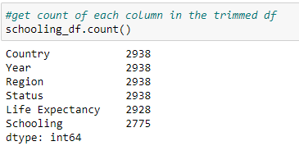
Data Cleaning cont.

Slide 6
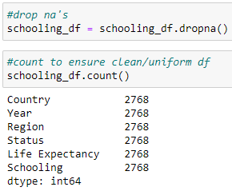
Data Cleaning cont.

Slide 7
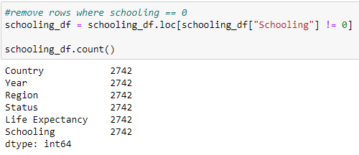
Data Cleaning cont.

Slide 8
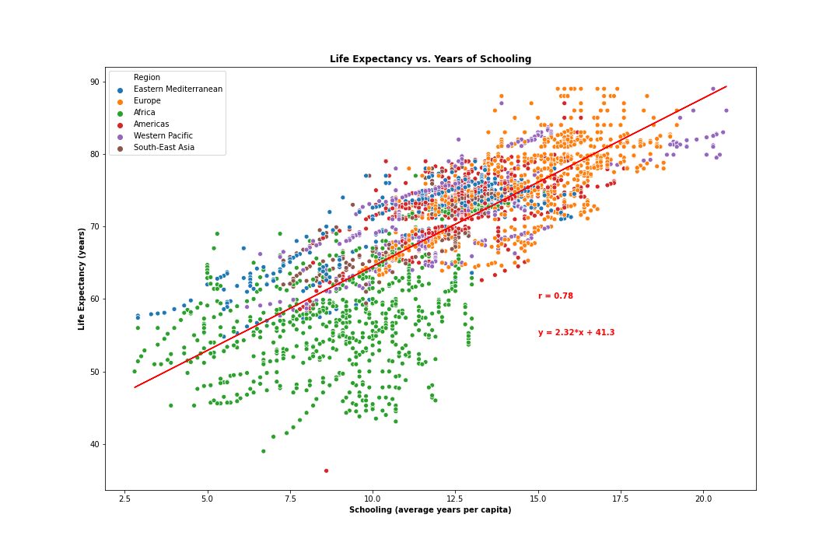
Life Expectancy vs. Schooling (Consolidated)
Notes:
This slide is looking at Life Expectancy vs. Years of Schooling consolidated (both Developing and Developed countries included in the dataset)
Correlation coefficient of .78 suggests strong correlation between a country’s education increases and increase in its life expectancy
Positive slope and positive correlation coefficient means a direct relationship which is what we would expect
Whether this is causation or simply correlation is unclear, to be investigated in the next couple slides (obviously causation cannot be implied unless there is a randomized controlled experiment, but we can conjecture about the possible relationship).

Slide 9
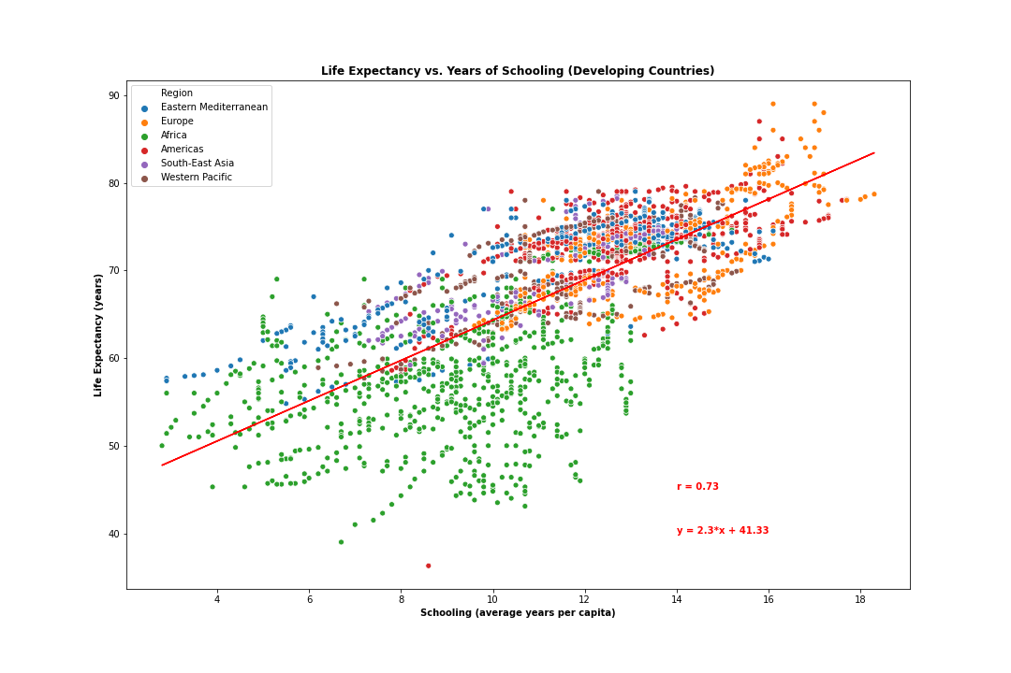
Life Expectancy vs. Schooling (Developing)
Notes:
This slide is looking at life expectancy vs schooling for Developing countries
Strong correlation coefficient and positive linear relationship
Potential confounding variables – as a country strives for development, education and health will improve independent of each other but both will show improvements over time, and thus show strong correlation. This is evident in the next graph, as Developed countries schooling and life expectancy showed a weak relationship, indicating that there is not causation between a countries increase in schooling and increase in life expectancy, but rather the strong correlation seen here is influenced by some confounding variable as Developing countries seek development.

Slide 10
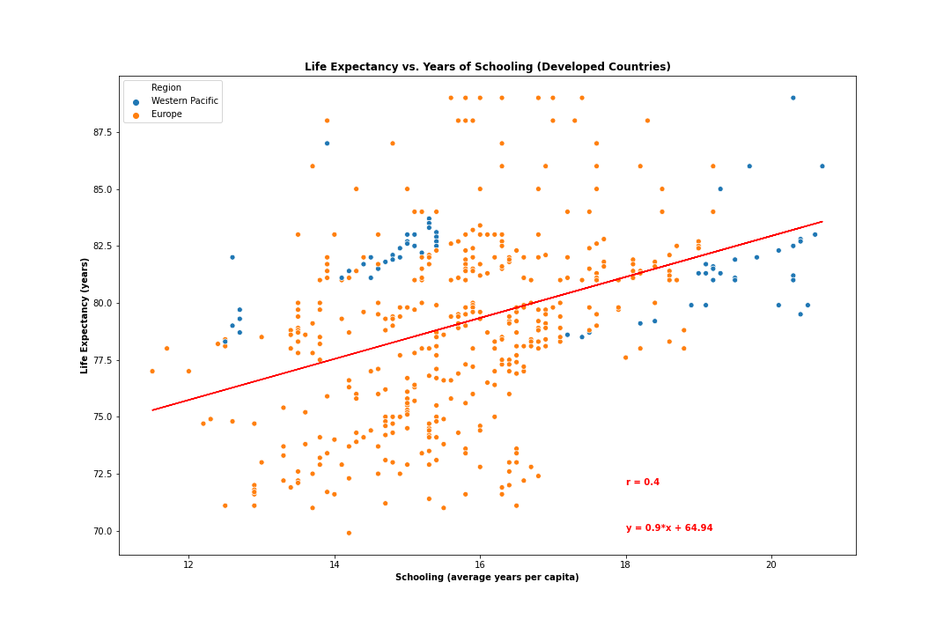
Life Expectancy vs. Schooling (Developed)
Notes:
This slide is looking at Life Expectancy vs. Education for Developed countries
Weak to moderate correlation coefficient of .4
Weak relationship because Developed countries already have strong education sectors. So, we see life expectancy increasing at a faster rate than schooling (as indicated by the individual slopes of life expectancy and education over time). The higher slopes for Life expectancy in the individual over time graphs also points to additional factors outside of schooling that would increase a country’s life expectancy. The Developed countries already have strong education systems in place, so the schooling will not increase as fast as life expectancy.

Slide 11
Conclusion: Life Expectancy vs. Schooling
Strong correlation overall and specifically for developing countries
Weak correlation for developed countries
Correlation not causation
Notes:
Based on the data analysis, we conclude that the relationship between a country’s schooling and its life expectancy is one of correlation rather than causation. This is driven by the face that there is a weak correlation coefficient between Life Expectancy and Schooling for developed countries. This indicates that the reason there is strong correlation between life expectancy and schooling for developing countries is because both variable are increasing independent of the other as a developing country becomes more developed in the 21st century. Countries will spend more on healthcare, vaccinations, and schooling and thus life expectancy and schooling will improve in congruence. However, I don’t believe there is a causal relationship.

Slide 12
Immunizations/Disease
Variables
Diseases
HIV/AIDS (Deaths per 1,000 births 0-4 years old)
Measles (reported cases per 1,000 of population)
Immunization Coverage among 1 year-olds (%)
Polio
Hepatitis B
Diphtheria-Tetanus-Pertussis (DTP3) Vaccination

Slide 13
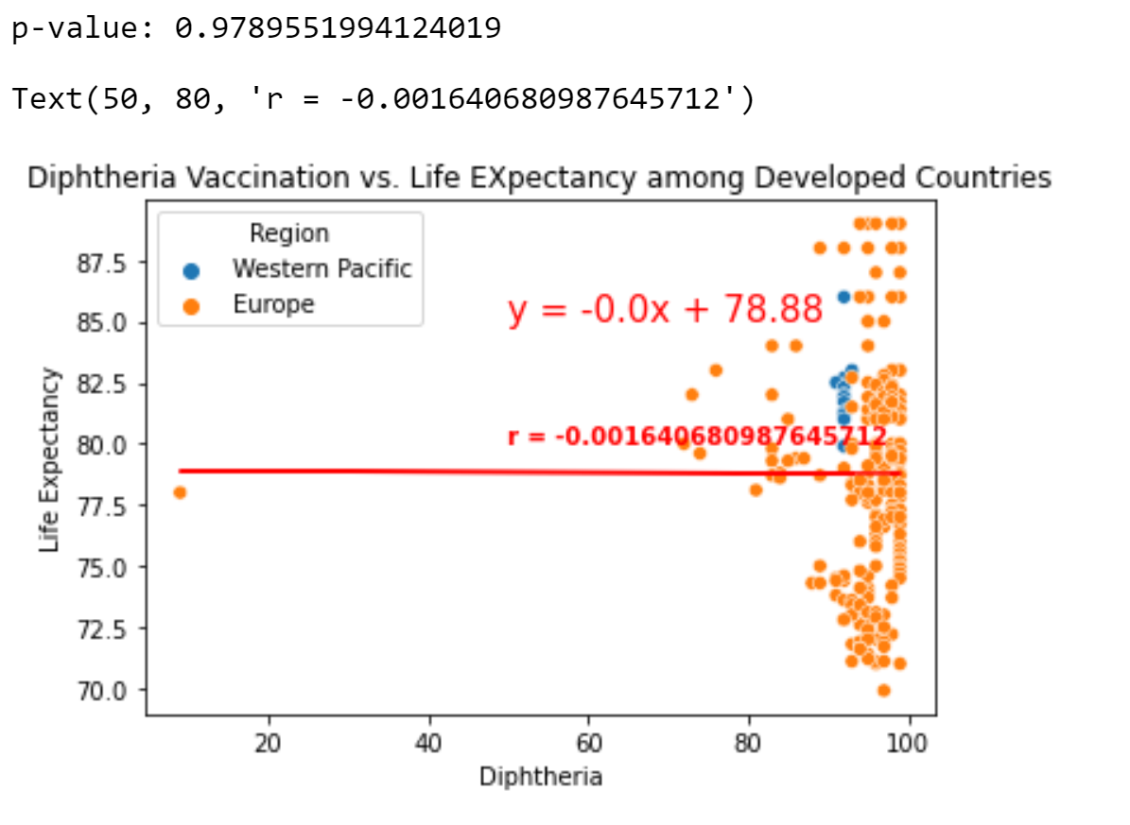
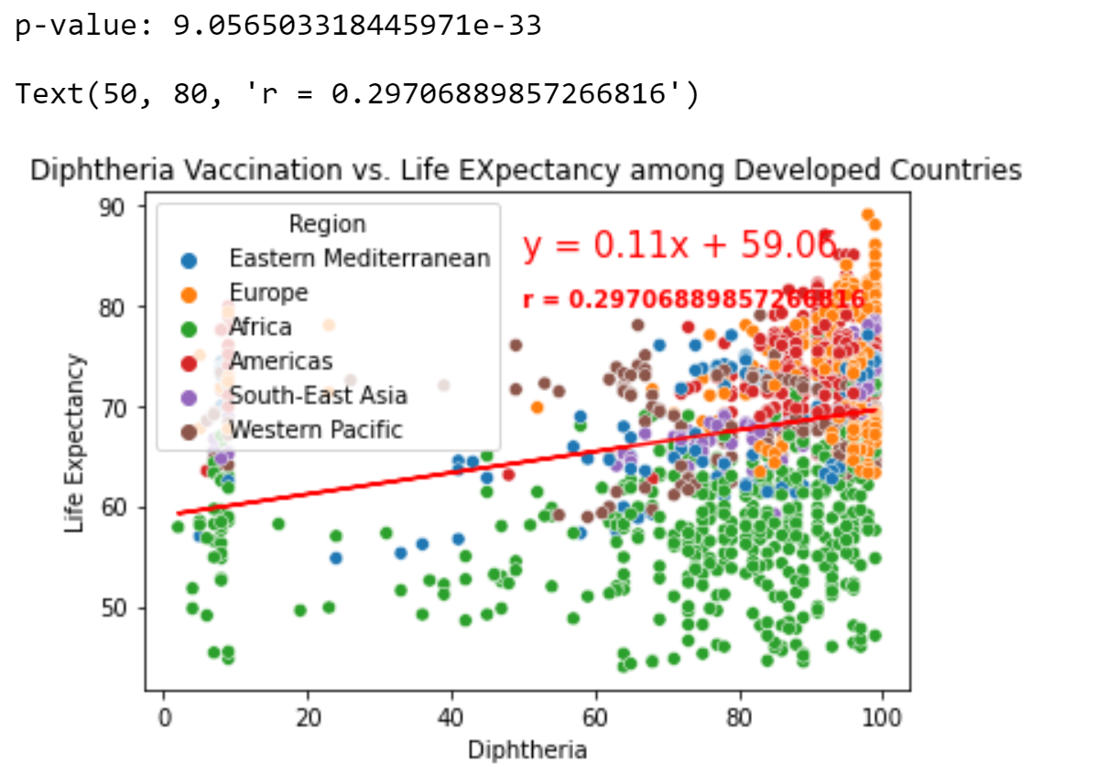
DTP3 Compared: Developing vs. Developed

Slide 14
Multi Linear Regression
Compound Variables vs. Life Expectancy
3 Vaccinations in Developing Countries:
R-squared: 0.107 (10% of variance in Life Expectancy)
2 Diseases in Developing Countries
R-squared: 0.345 (34% of variance in Life Expectancy)
HIV/AIDS Coeff: ~1
Wide Confidence Interval: [0.025 to 0.975]
Other factors distort meaning

Slide 15
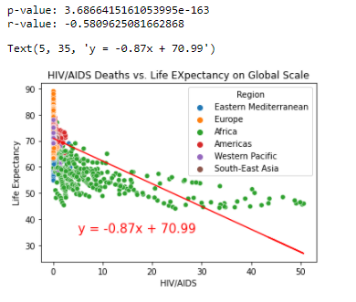
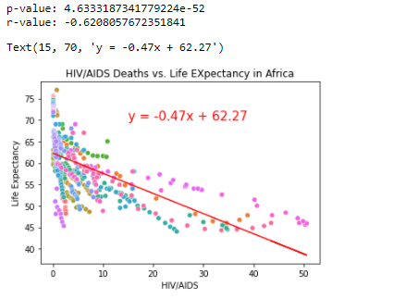

HIV Outliers Extreme outbreaks decrease overall life expectancy

Slide 16
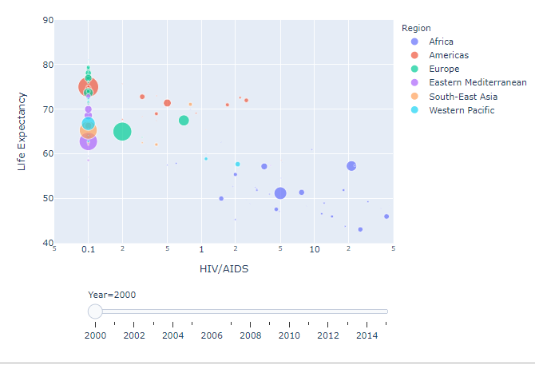
View Plotly in Notebook

Slide 17
Conclusions/Further Research
Wide Confidence Interval
Sample Size: short period of 16 years to see long term effects
Variability: Confounding Factors
Low r2 Value
Common in social sciences
High HIV/AIDS rates cause Life Expectancy to go down on paper
Further Research will need to include longer period of data collection and intro of new variables (specific mortality stats)

Slide 18
BMI vs. Life Expectancy: Hypotheses & Tests
Linear Regression
H₀: The slope of the regression line is 0 (i.e. β₁=0).
H₁: The slope of the regression line is not 0 (i.e. β₁≠0).
Chi-Squared Test (also called an Association Test)
H₀: p_{Developed,High BMI} = p_{Developing,High BMI}
H₁: p_{Developed,High BMI} > p_{Developing,High BMI}
^
^

Slide 19
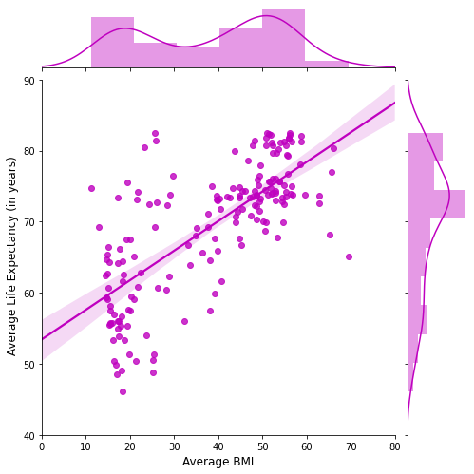
BMI vs. Life Expectancy
R = 72.38%
R-Squared = 53.39%

Slide 20
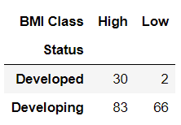
Country Status vs. BMI Classification
Who is most likely to have a high BMI? Low BMI?

Slide 21
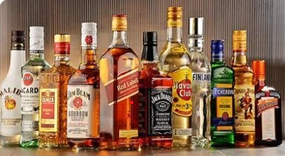
Alcohol vs. Life Expectancy

Slide 22
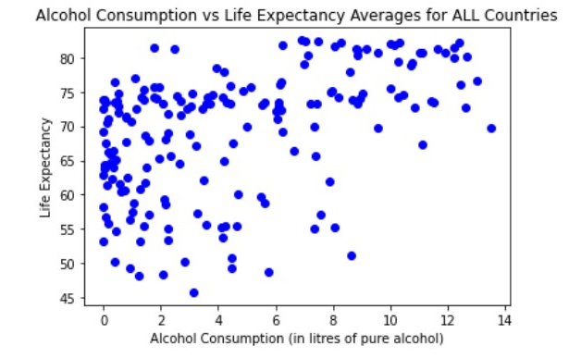
Broader Overview
Notes:
Both average Life Expectancy for developed countries and for developing countries since 2000-2015
I was surprised to see that it was mixed information and was not as clear cut as expected.
In looking at the upper right of the quadrant, it gives the impression that there is a link between drinking and life expectancy.
However, when looking at the left half of the screen, there does not appear to be any link with drinking less alcohol/ The life expectancies are
varied for the same range of alcohol consumption

Slide 23
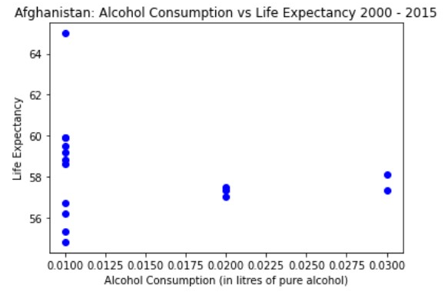
Deep Dive: Afghanistan
Notes:
Afghanistan alcohol consumption vs. Life Expectancy has been expanded to include the actual data instead of the average
The average life span was identified to be 59+ years based on an average alcohol consumption of 0.014 litres of pure alcohol

Slide 24
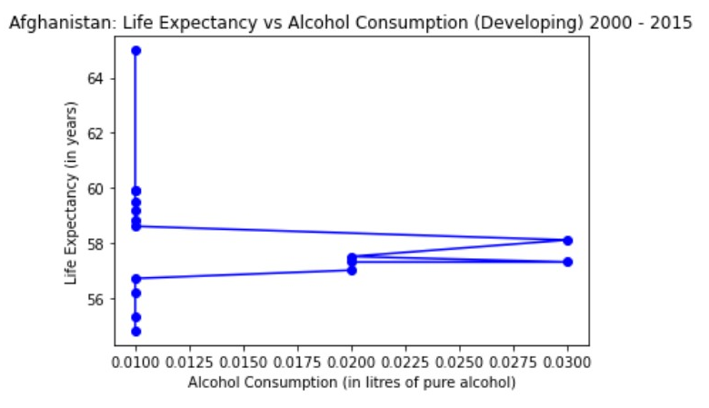
Deep Dive: Afghanistan
Notes:
Something to note here…
In general, the alcohol consumption is averaging 0.014, the life expectancy is increasing,
Even when alcohol consumption increases a bit, life expectancy us still rising.

Slide 25
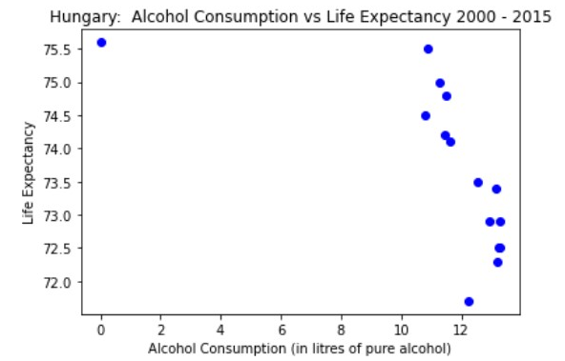
Deep Dive: Hungary
Notes:
Hungary alcohol consumption vs. Life Expectancy has been expanded to include the actual data instead of the average
The average life span was identified to be 73.69 years based on an average alcohol consumption of 11.42 litres of pure alcohol

Slide 26
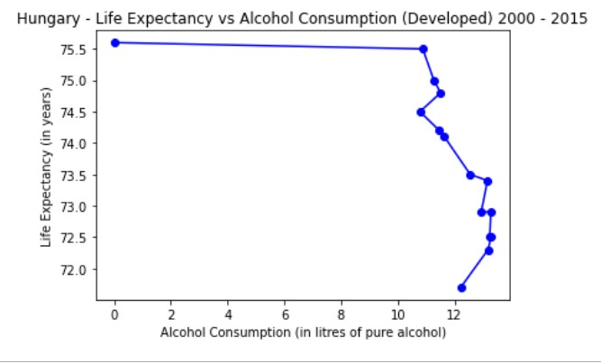
Deep Dive: Hungary
Notes:
Something to note here…
Although the alcohol consumption is averaging 11.42, it is noted that alcohol consumption is decreasing ever so slightly over the years.
This could be attributing to an increase in life expectancy,
Suspect other factors are in play which contribute to this and there was not enough time or data to dig deeper.
and the life expectancy is increasing even though there is a higher consumption

Slide 27
Conclusion: Alcohol vs. Life Expectancy
No independent correlation between the two
There may be other factors contributing to an increase in life expectancy
There is opportunity to gather more targeted
data for further research.
Example:
Gender, Ethnicity, frequency and timing of drinking, Does Alcoholism run in the family, etc.

Slide 28
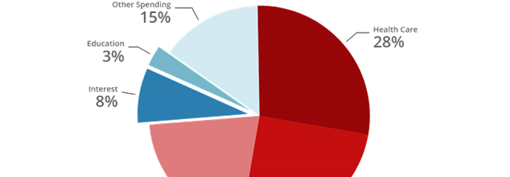
Life Expectancy vs. Government Health Expenditure
Government Health Expenditure:
The funds dedicated to national health care as a percentage of the total budget.

Slide 29
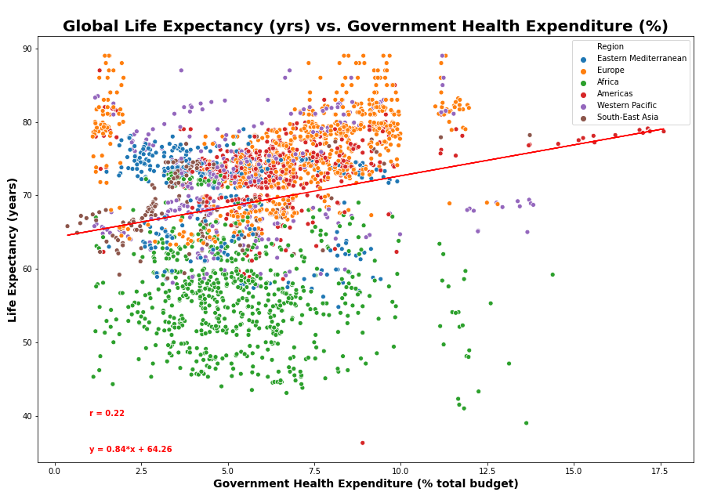
Life Expectancy vs. Expenditure (Global)

Slide 30
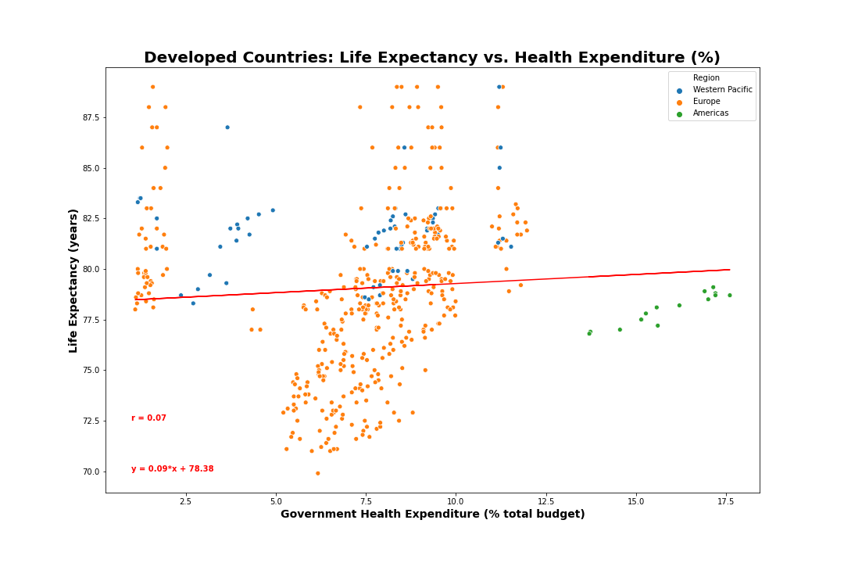
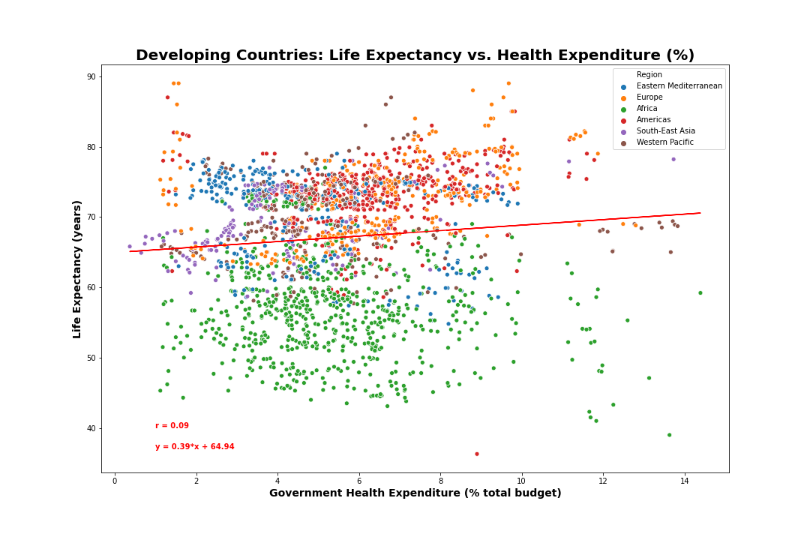
Developed vs. Developing Countries

Slide 31
Conclusion: Life Expectancy vs. Government Expenditure
Weak correlation overall.
Additional data collection and analysis required to view meaningful results.
Collect data over longer period – will an investment made today have an impact on life expectancy in 50 years?
Gather more information on GDP & population
Perform further analysis to find other potential non-linear associations

Slide 32
Overall Conclusion
Clear correlation between Schooling & BMI vs life expectancy in developing countries.
Not enough evidence to reject the null hypothesis relating to Disease/Immunization, Alcohol Consumption, and Health Expenditure.
Further data collection required.

